Slide 1
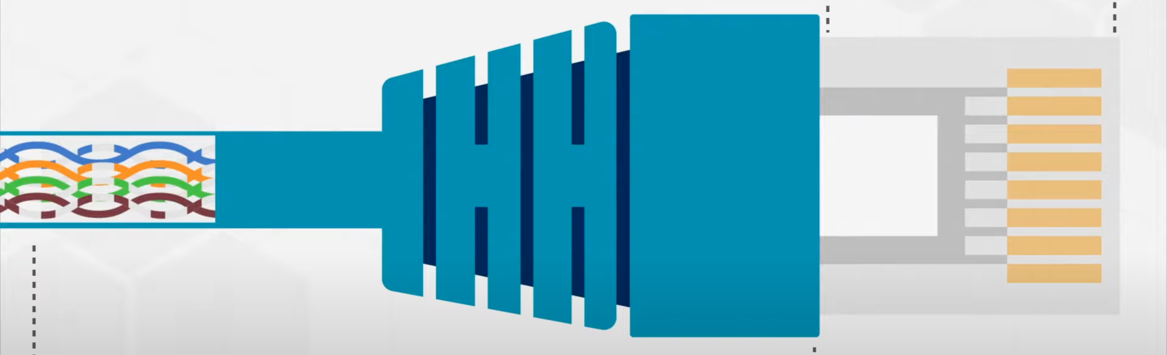
Introduction to Ethernet
Definition: Ethernet is a technology that connects devices within a local area network (LAN) or wide area network (WAN), enabling them to communicate via a common protocol.
History: Developed in the 1970s by Xerox, it has become the dominant LAN technology, standardized by IEEE as IEEE 802.3.
Purpose: Ethernet enables reliable, high-speed data transmission in both wired and wireless network configurations.

Slide 2
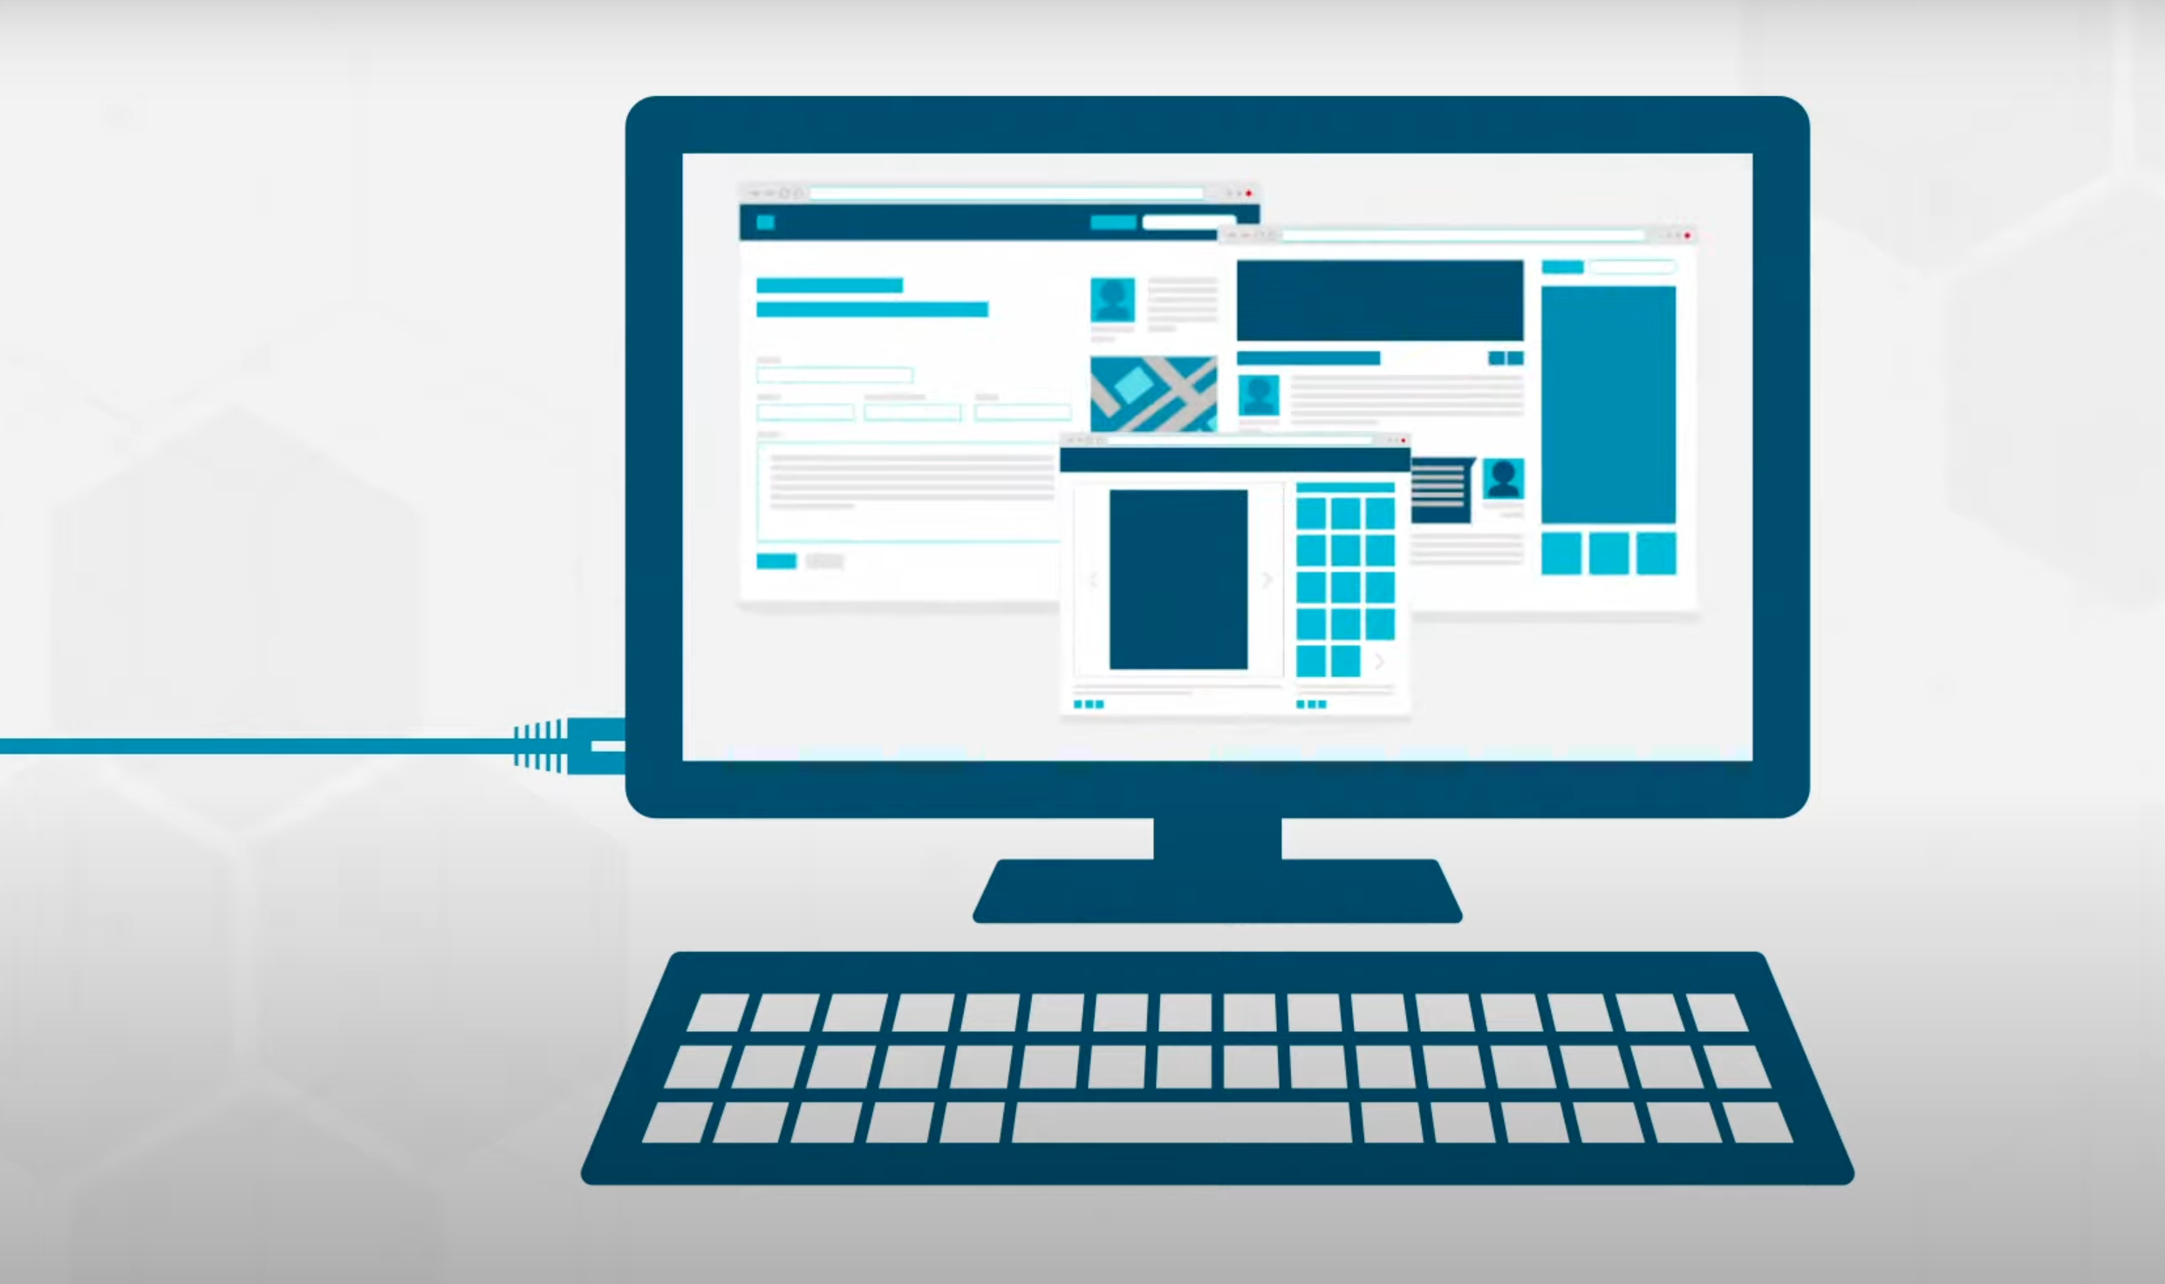
Basic Ethernet Concepts
MAC Address: Unique identifier assigned to network interfaces for communications on the physical network.
Frames: Data in Ethernet is sent in packets called frames, which contain headers with destination and source MAC addresses, data, and error-checking information.
Speed Variants: Ranges from traditional 10 Mbps to modern speeds like Gigabit Ethernet (1 Gbps), 10 Gigabit, and even up to 400 Gbps.

Slide 3
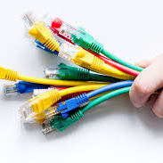
Ethernet Standards and Types
Ethernet Types by Speed:
- Fast Ethernet (100 Mbps)
- Gigabit Ethernet (1000 Mbps)
- 10 Gigabit Ethernet
- 40/100/400 Gigabit Ethernet for high-performance networks
Wired vs. Wireless Ethernet: Wired Ethernet uses cables (often copper or fiber optic), while Wireless Ethernet (Wi-Fi) allows devices to connect over radio frequencies.

Slide 4
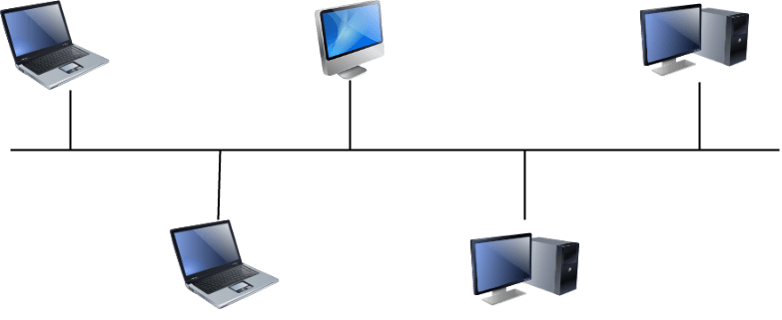
Ethernet Topologies(BUS)
Structure: In a bus topology, all devices are connected to a single, central communication line.
Advantages:
Cost-Effective
Easy to Extend
Disadvantages:
Collision Issues
Fault Sensitivity
Limited Scalability
Use Cases: Rarely used today in Ethernet networks but may be found in small, where cost is a significant factor.

Slide 5
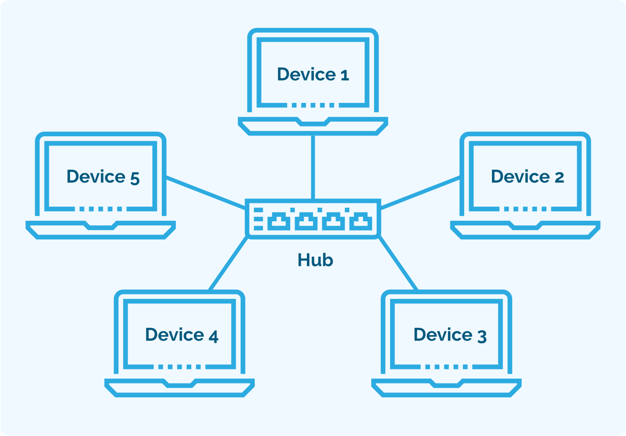
Ethernet Topologies(STAR)
Structure: In star topology, each device on the network is connected to a central hub or switch.
Advantages:
Fault Tolerance
Scalability
Efficient Data Management
Disadvantages:
Central Point of Failure
Cost
Use Cases: Star topology is the most common structure for Ethernet networks today, used in homes, offices, and data centers due to its reliability and ease of expansion.

Slide 6
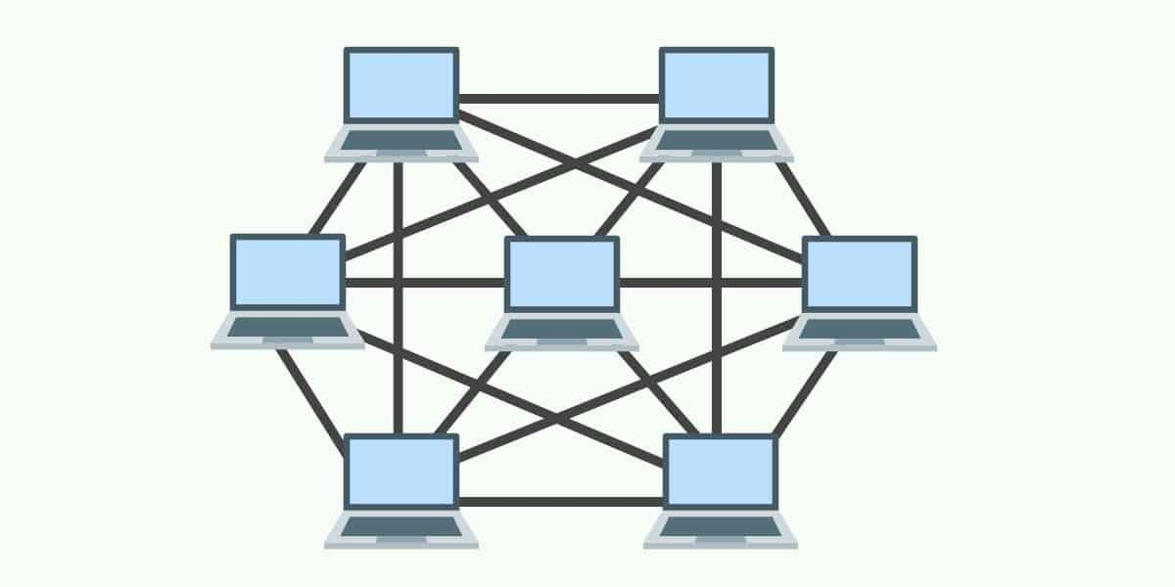
Ethernet Topologies(MESH)
Structure: In a mesh topology, each device is connected directly to other devices on the network, creating multiple paths for data to travel.
Advantages:
Redundancy and Fault Tolerance
Optimal Traffic Flow.
Disadvantages:
Complexity and Cost
High Resource Requirement
Use Cases: Mesh topology is uncommon in standard Ethernet networks but is used in scenarios where requiring high availability and reliability, such as data centers, critical infrastructure, and wireless networks (e.g., Wi-Fi mesh networks).

Slide 7
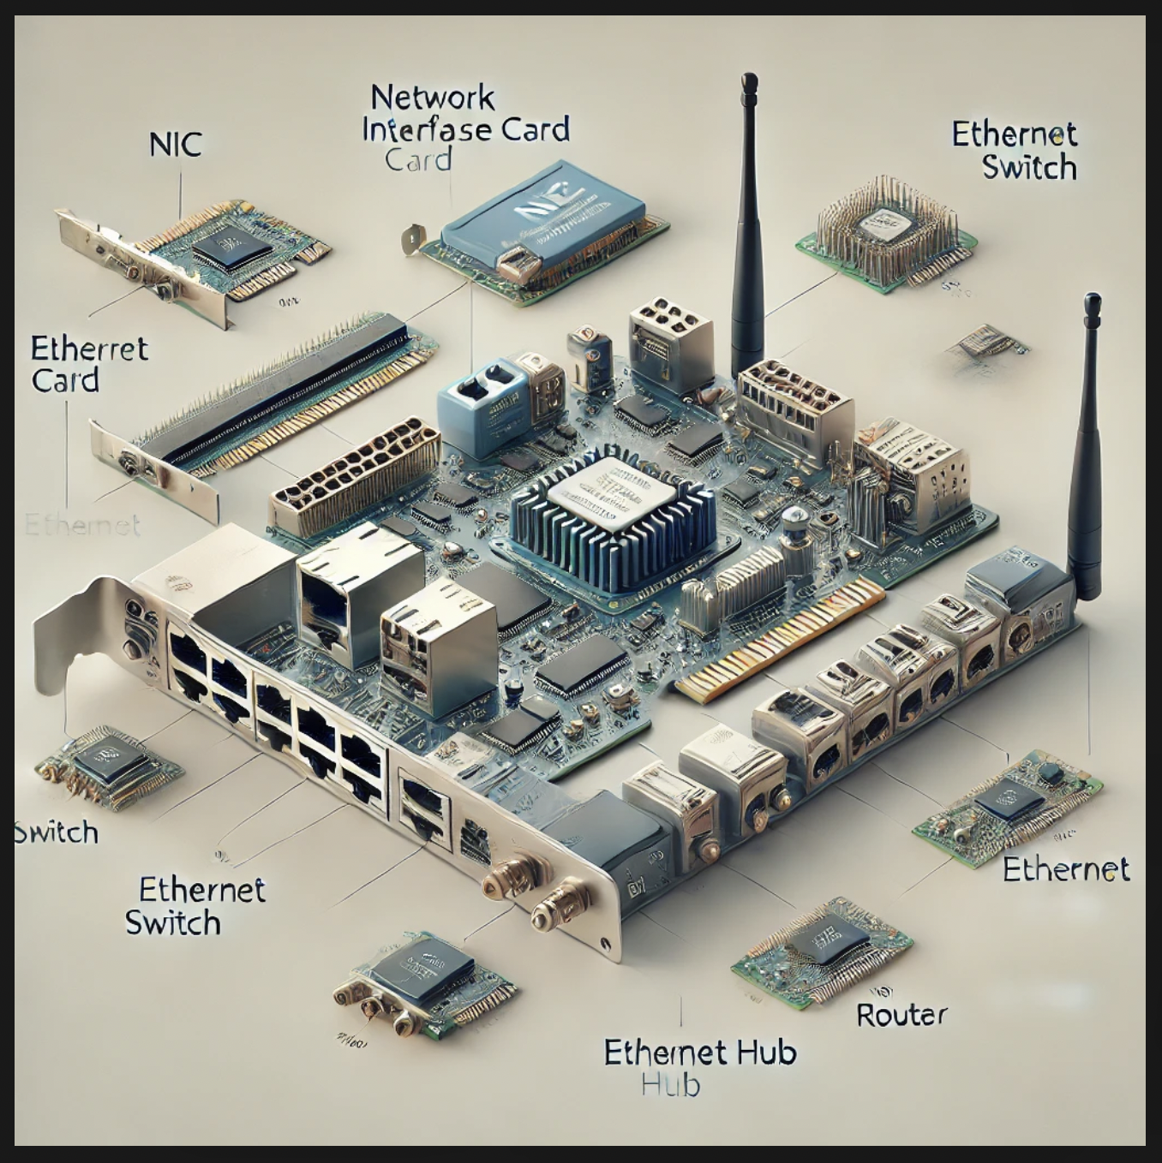
Ethernet Hardware Components
Network Interface Card (NIC): Allows devices to connect to Ethernet networks.
Ethernet Switch: Provides multiple Ethernet ports for connecting devices within a network, directing data traffic efficiently.
Hub: As a simpler, older device that connects multiple Ethernet devices, sending data to all ports without directing traffic.
Router: Connects local networks to the internet and directs data between devices in a network.

Slide 8
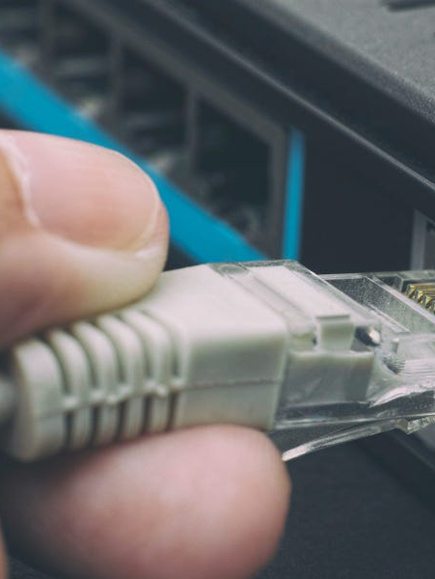

How Ethernet Works
Physical Connection: Ethernet cables connect through a switch or router.
MAC addresses: Each device has a unique MAC address for identification on the network.
Frames and Packets: Data is sent in frames containing source/destination MAC addresses, control informations.
Collision Detection (CSMA/CD): Used to manage data transmission and reduce data collisions.
Data Rates: Ethernet supports speeds of 100 Mbps, 1 Gbps, and up to 400 Gbps.
Error Checking: Frames have CRC(Cyclic Redunsancy Check) for error detection.
Encoding Technique: Use Manchester ecoder tecnique.

Slide 9
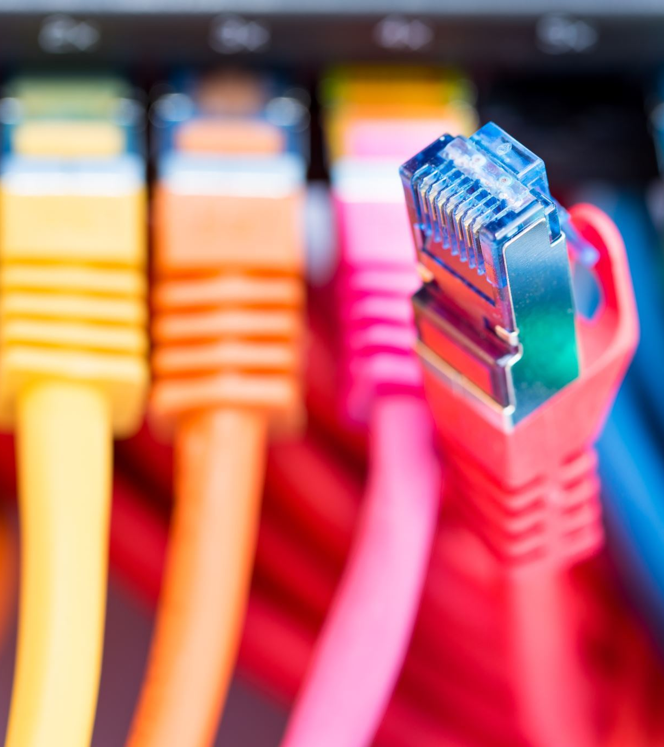
Modern Ethernet Technologies
PoE+
100 GbE
VLAN Trun king
Multi-Gig Ethernet
Software-Defined Ethernet
Ethernet over Fiber Channel
EVPN
Time-Sensitive Networking - TSN

Slide 10
Modern Ethernet Technologies
PoE+
100 Gigabit Ethernet(100GbE)
VLAN Trunking
Multi-Gig Ethernet
Software-Defined Ethernet
Ethernet over Fiber Channel
EVPN
Time-Sensitive Networking - TSN

Slide 11

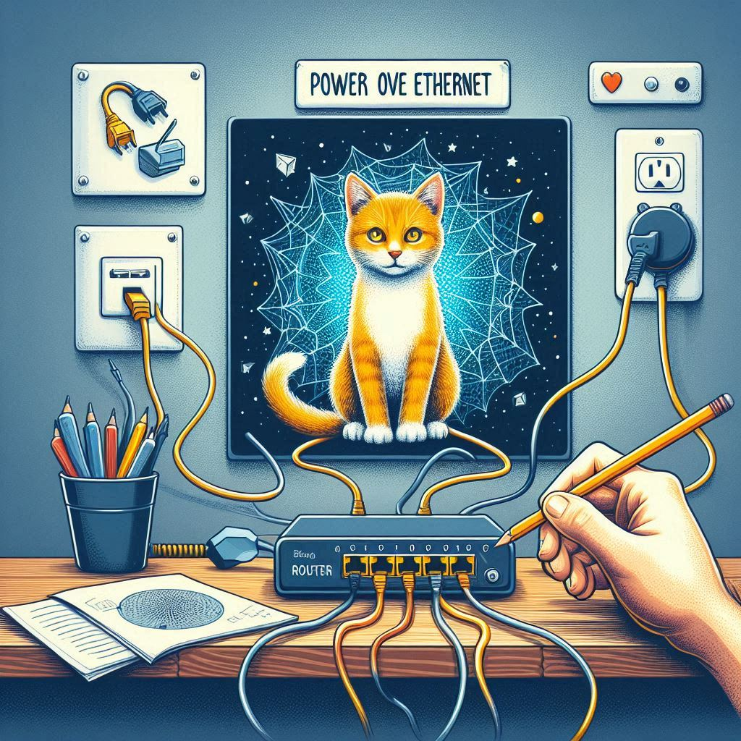
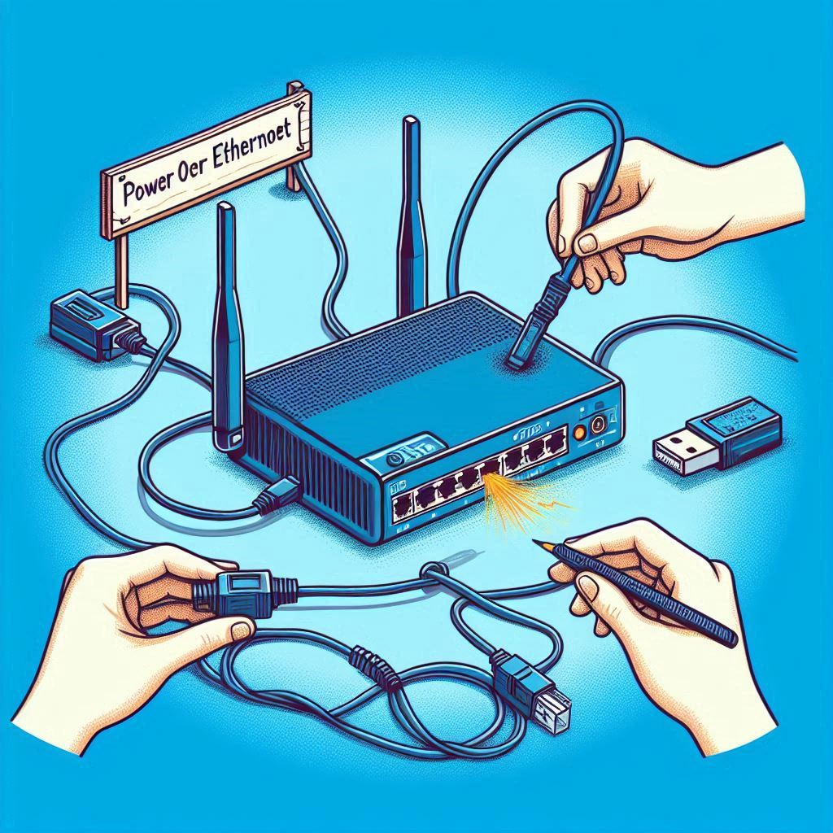
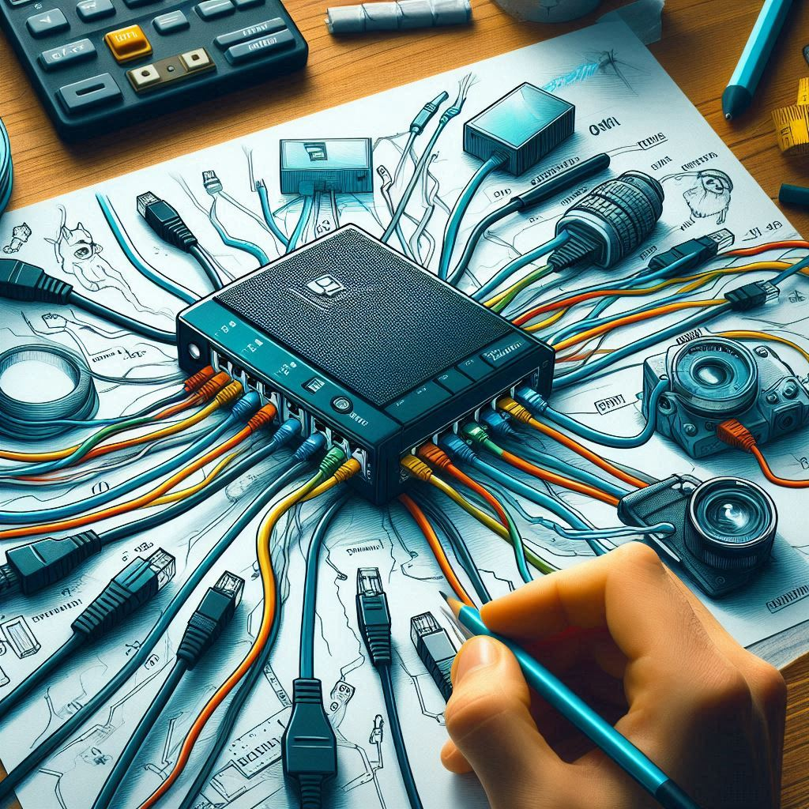
PoE + (Power Over Ethernet Plus)
Power over Ethernet plus (PoE)is an advanced version of PoE that can provide more power to devices. While standard PoE is suitable for lower-power devices, PoE+ can deliver up to 25.5 watts of power.

Slide 12
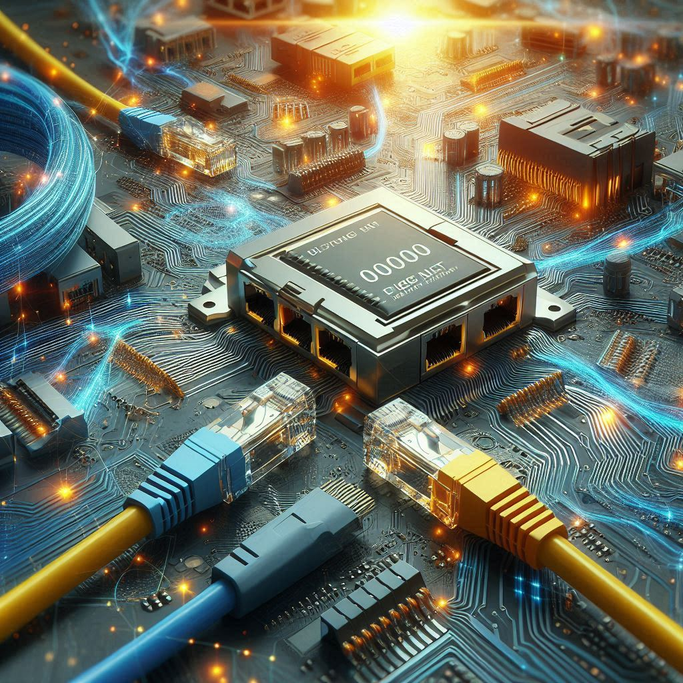
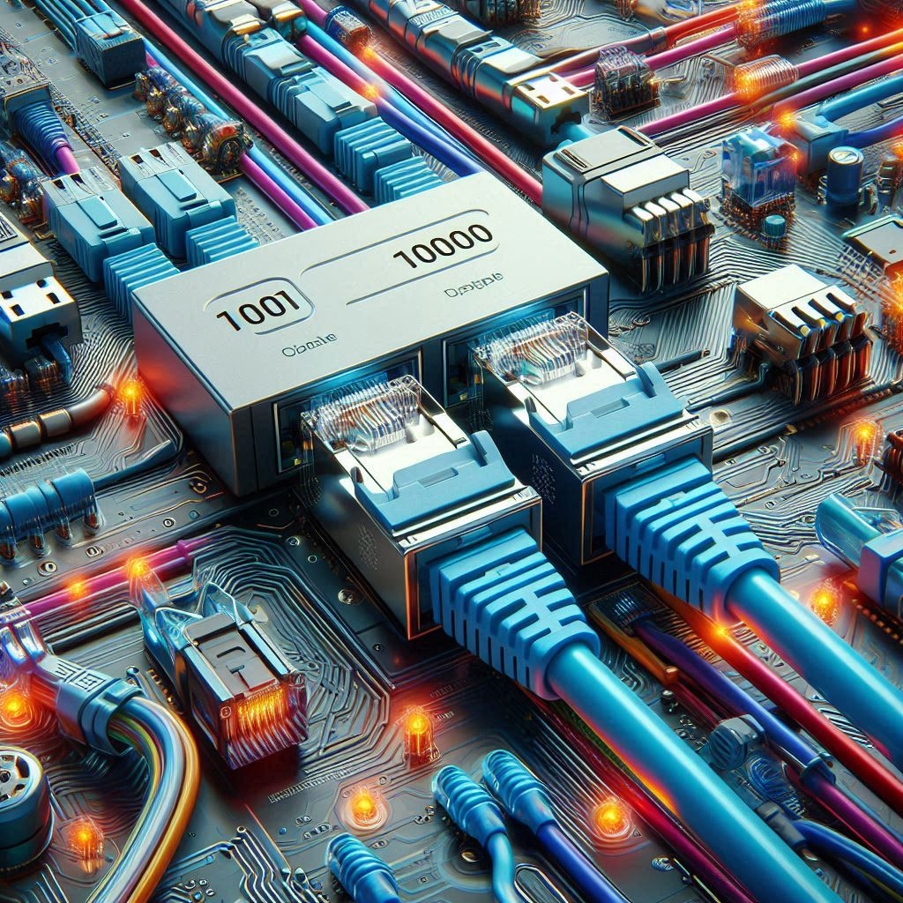
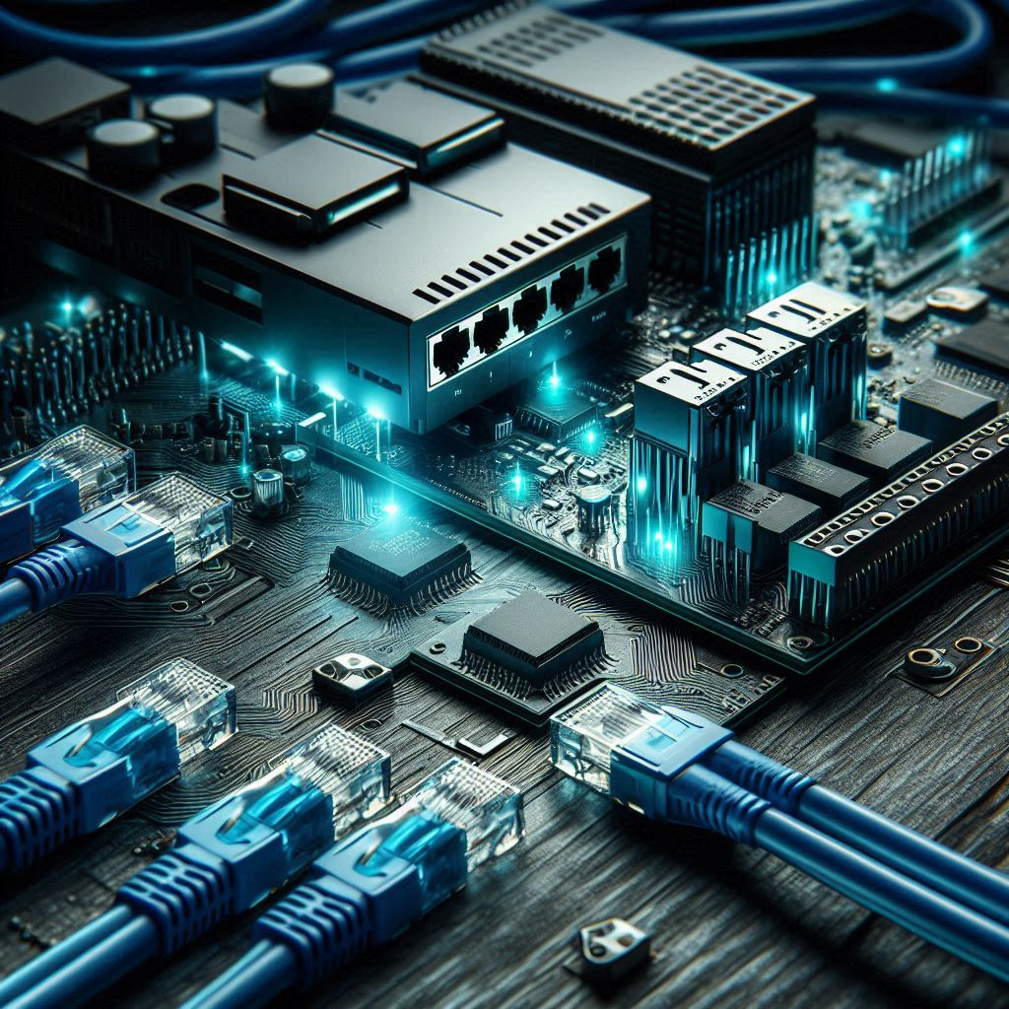
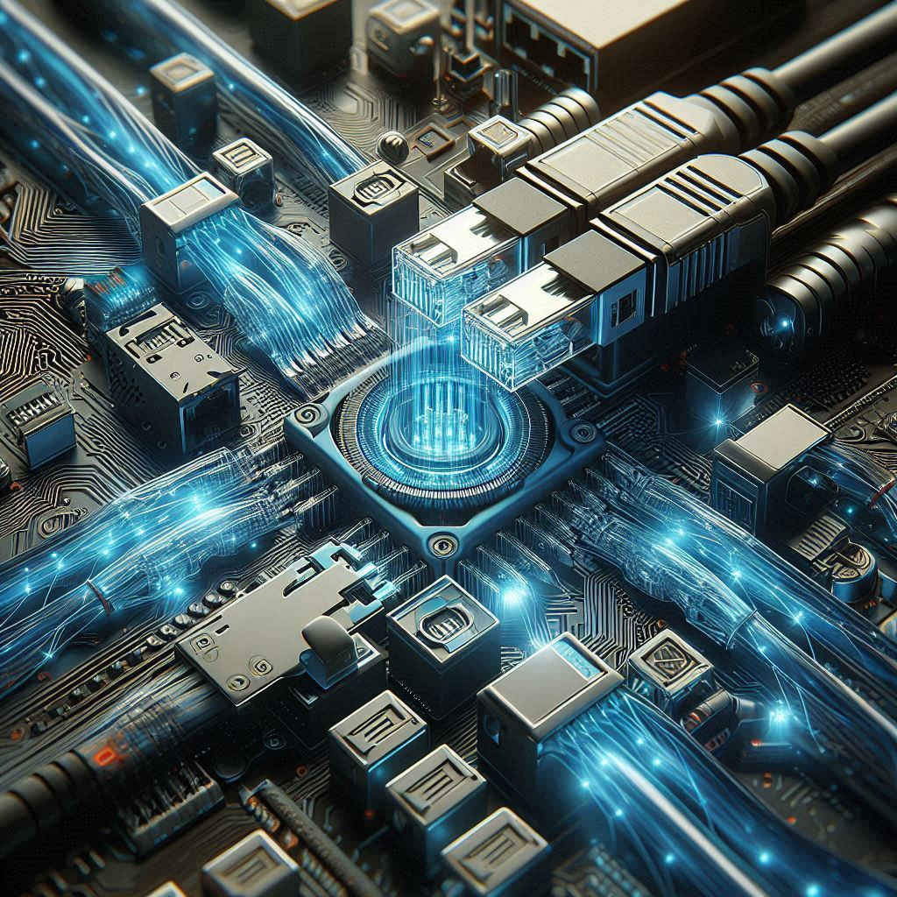
100 Gigabit Ethernet (100 GbE):
100 Gigabit Ethernet (100 GbE) is an Ethernet technology used for transferring large amounts of data at very high speeds. It can transmit data at a rate of 100 gigabits per second, which is significantly faster than standard Ethernet.

Slide 13




VLAN Trunking​
VLAN Trunking is a technology that allows data from multiple VLANs (Virtual LANs) or virtual networks to be carried over a single cable. Normally, in a network, each VLAN would need its own separate cable, but with VLAN Trunking, all VLANs’ data can be transferred through just one cable.​

Slide 14
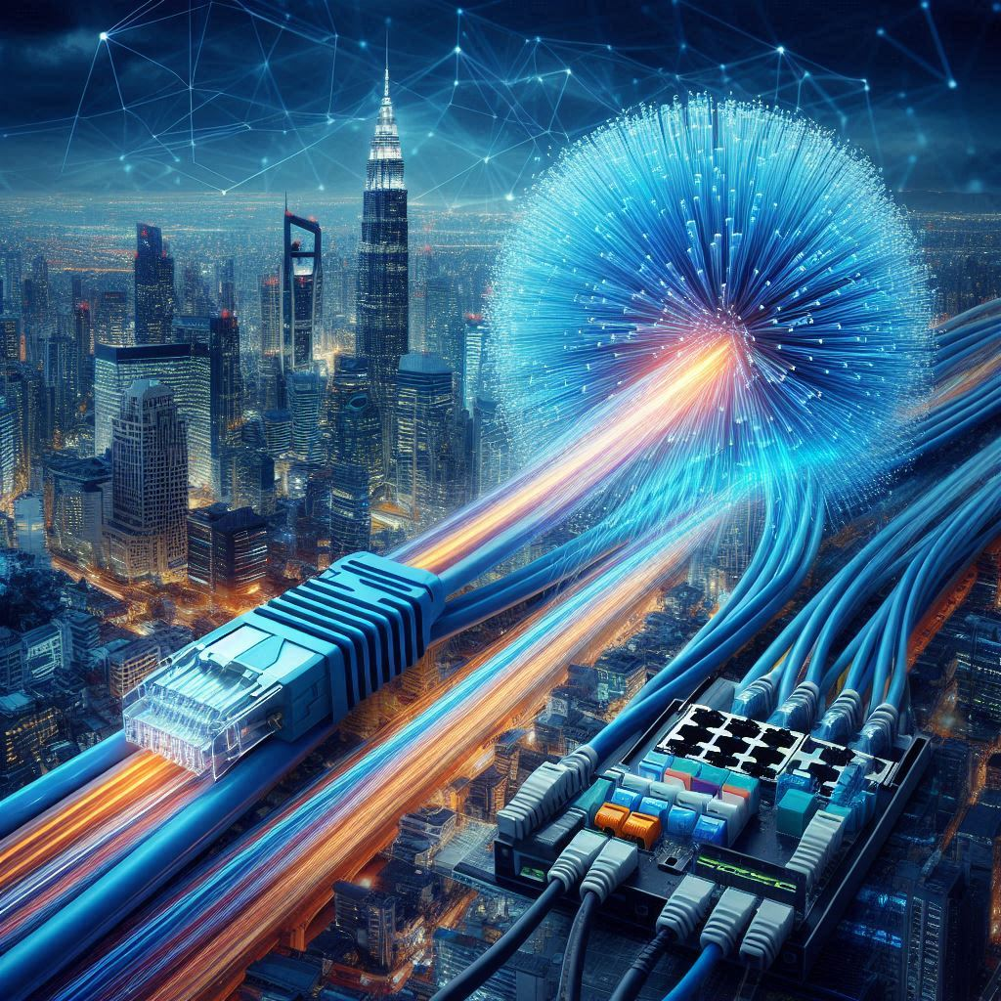
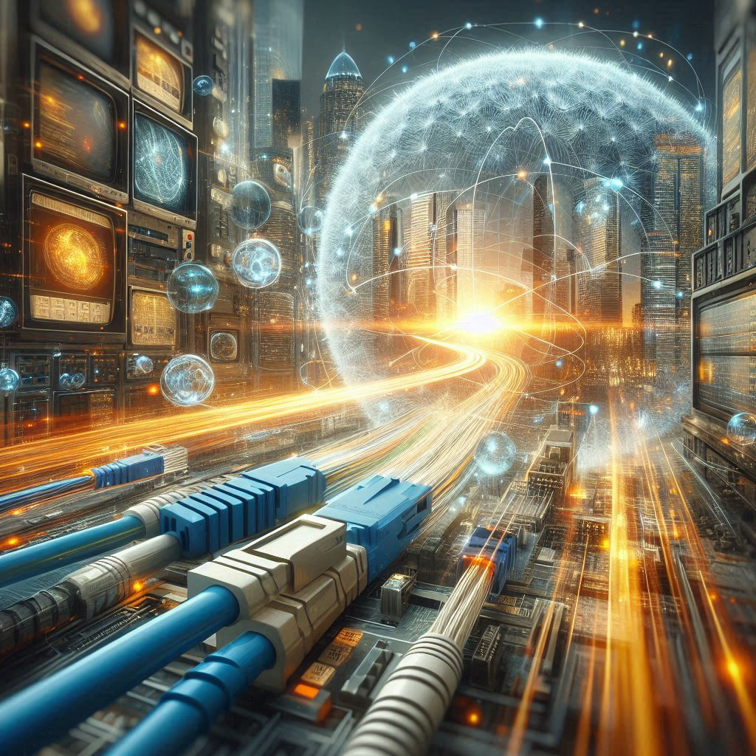
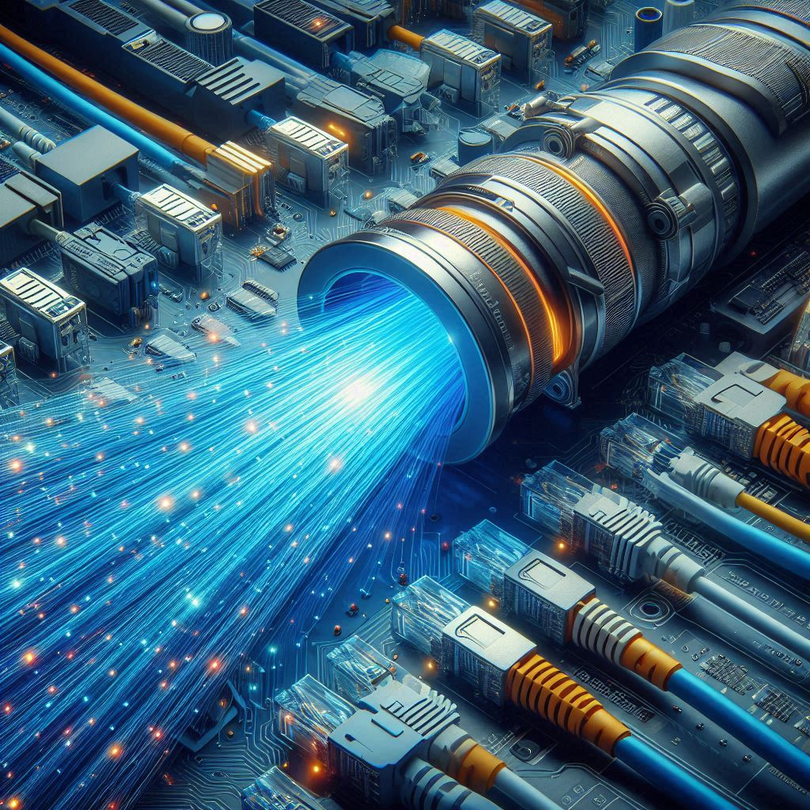

Ethernet over Fiber Channel
Ethernet over Fiber Channel is a technology that uses fiber channel to transmit Ethernet data. Fiber channels are capable of transferring data at high speeds over long distances, ensuring reliable data transfer in large-scale networks.

Slide 15
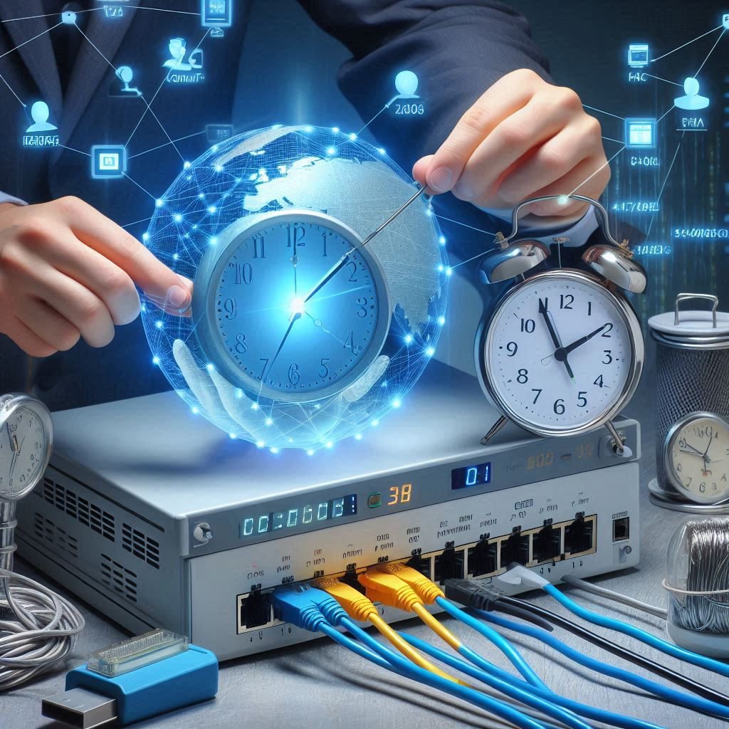
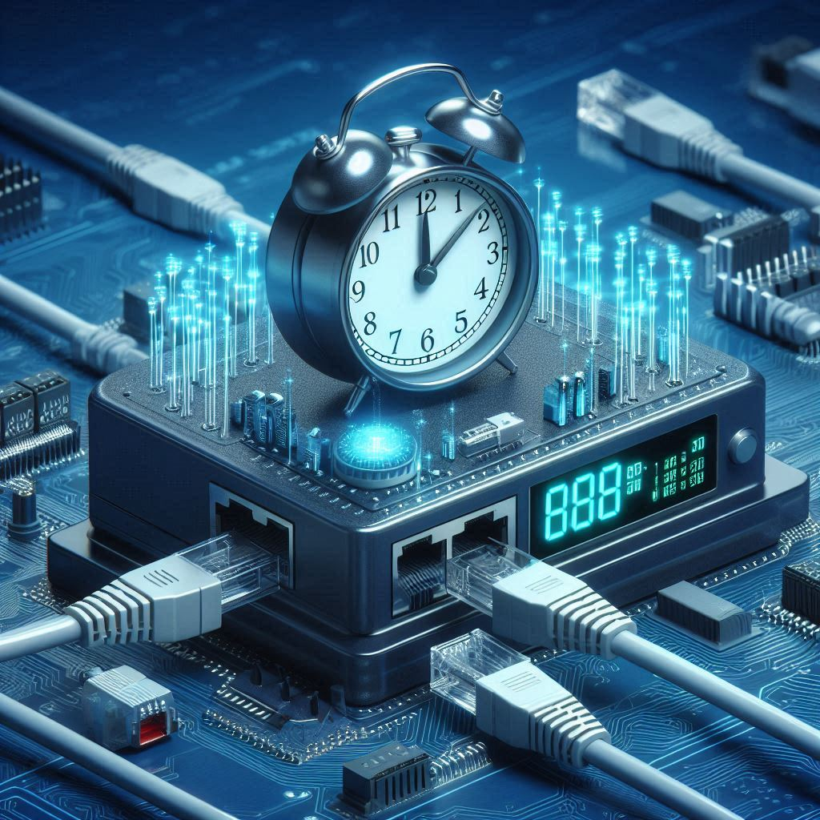
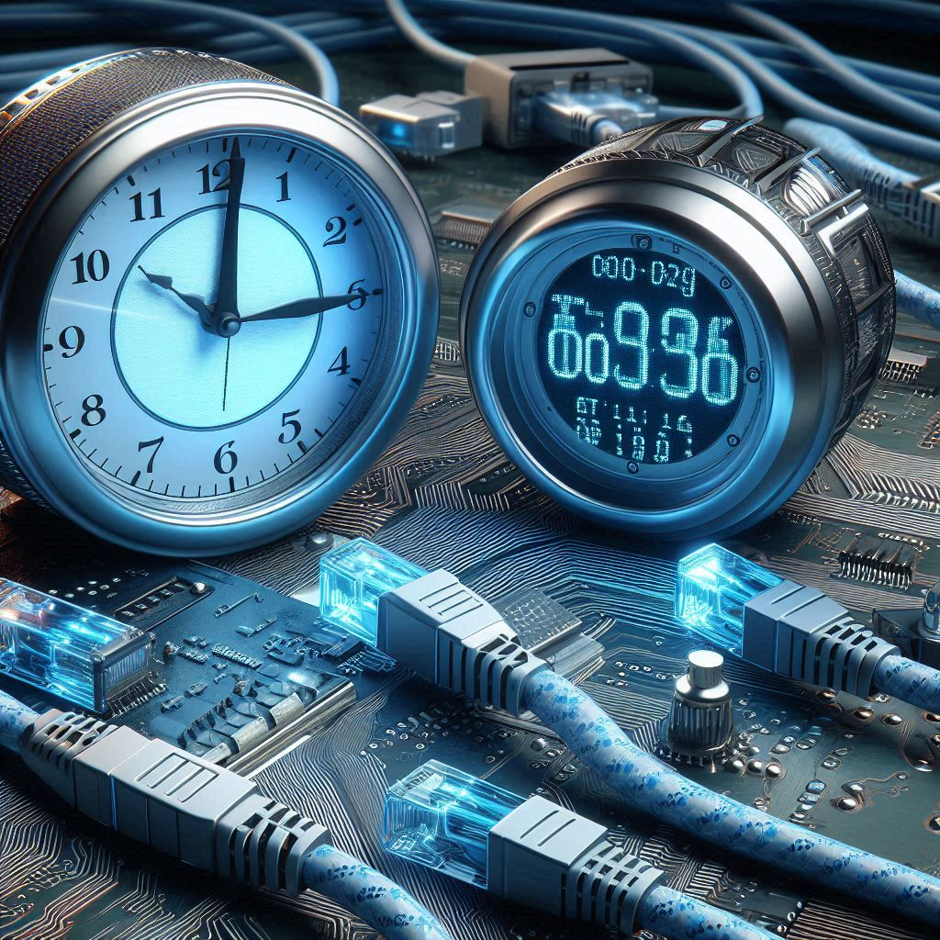
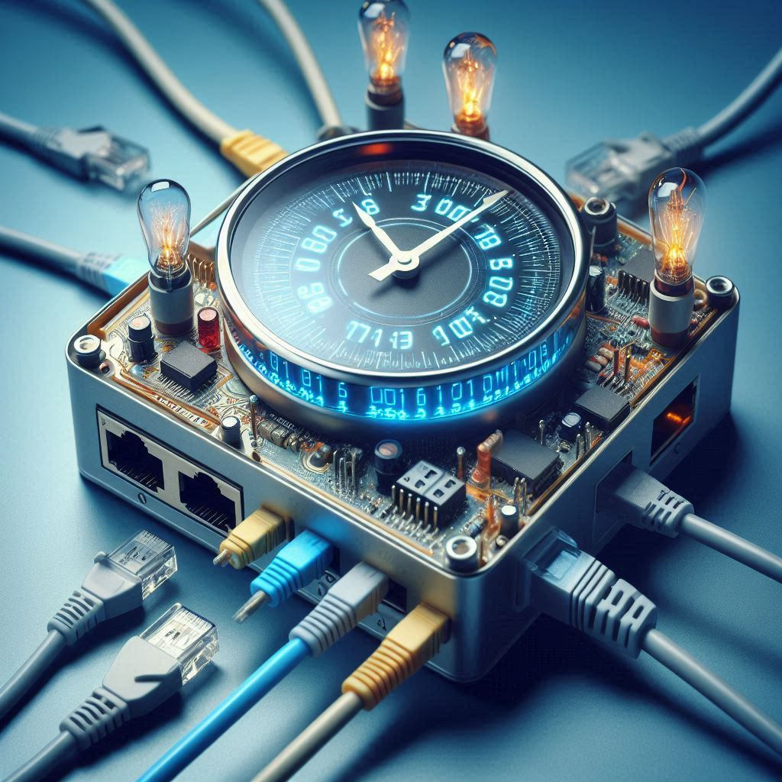
Time-Sensitive Networking (TSN)
Time-Sensitive Networking (TSN) is a technology that ensures data reaches its destination within a specific time frame. This means TSN allows data to be sent to the intended device or location precisely on time. It ensures that data reaches its destination at the correct time, avoiding any delay.

Slide 16

Advantages & Disadvantages Of Ethernet
Advantages | Disadantages
High Speed: Fast data transfer, ideal for high-bandwidth applications. | Limited Mobility: Requires physical cables, reducing device mobility.
Reliability: Stable connection with minimal interference. | Installation Complexity: Installing cables can be challenging, especially in large buildings.
Security: More secure than wireless, as physical access is needed. | Distance Limitations: Standard Ethernet cables are limited to 100 meters in range.
Cost-Effective: Affordable equipment and setup costs. | Network Expansion Challenges: Adding new devices requires extra ports and cables.
Low Latency: Minimal delay, good for gaming, streaming, and VoIP. | Cable Clutter: Multiple connections create cable management issues.

Slide 17
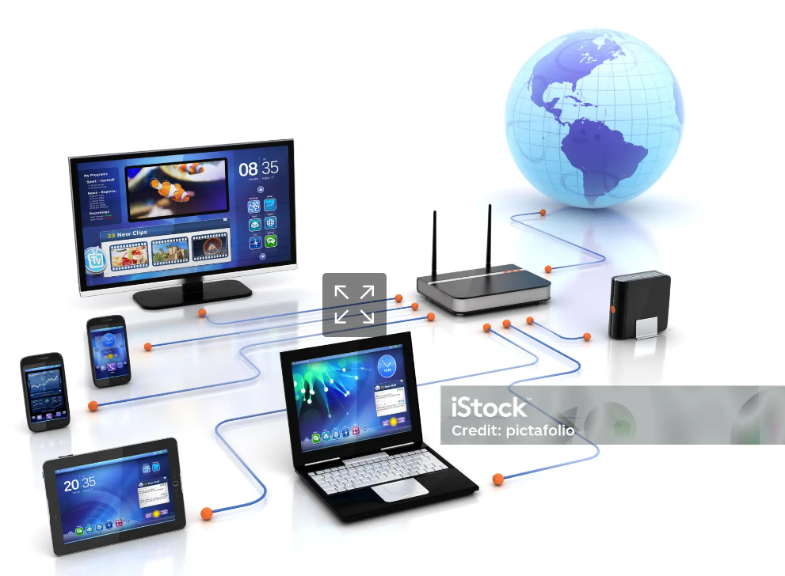
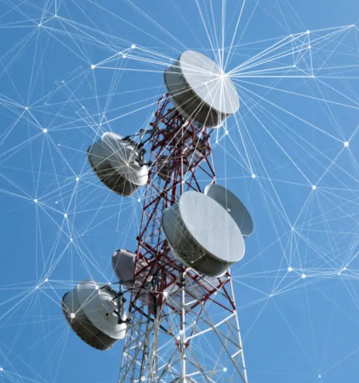

Applications of Ethernet
Home Networking
Telecommunications
Data Centers
Telecommunications companies use Ethernet to link equipment within their networks, supporting voice, video, and data transmission over large distances.
Ethernet connects the vast array of servers, storage devices, and network switches in data centers

Slide 18


Future of Ethernet
1 Artificial intelligence
2 Cloud computing
3 Real-time data analytics

Slide 19
Conclusion
Ethernet’s future is expansive, as it continues to evolve to support high-speed, low-latency communication across various domains, from industrial automation to cloud computing .As more applications rely on robust and fast networks, Ethernet will remain essential in shaping the future of connectivity.

Slide 20
Any question?

Slide 21
Thank you

